Slide 1
BDD microskill crafting constraints through tests
@LlewellynFalco

Slide 2
BDD vs Evil Programmer
@LlewellynFalco
Notes:
Behaviour Driven Development (BDD) is said to be able to evolve a good design and working code. But can it really?
This session is going to focus on the microskill of writing tests to craft code. While many people are comfortable with getting a happy path example, continuing to craft test to evolve a more complete specification is often undeveloped in the 3 amigos (developers, testers and business/product); This session will focus on learning this microskill. To aid in the feedback loop you (the audience) will write all the test. I (the presenter) will turn them into code and write code to make them pass. I will follow 3 rules:
All tests must pass
I'm not trying to help
but I'm also lazy
These come together to say, "If you can make it so it's easier for me to do the right thing than the wrong thing, then I will". Learning the microskill of crafting constraints through tests to achieve this is what the session is all about. On a typical session we will go thru this cycle about 15-20 times.
(Note: No coding is required to attend this session, but basic BDD skills are helpful)

Slide 3
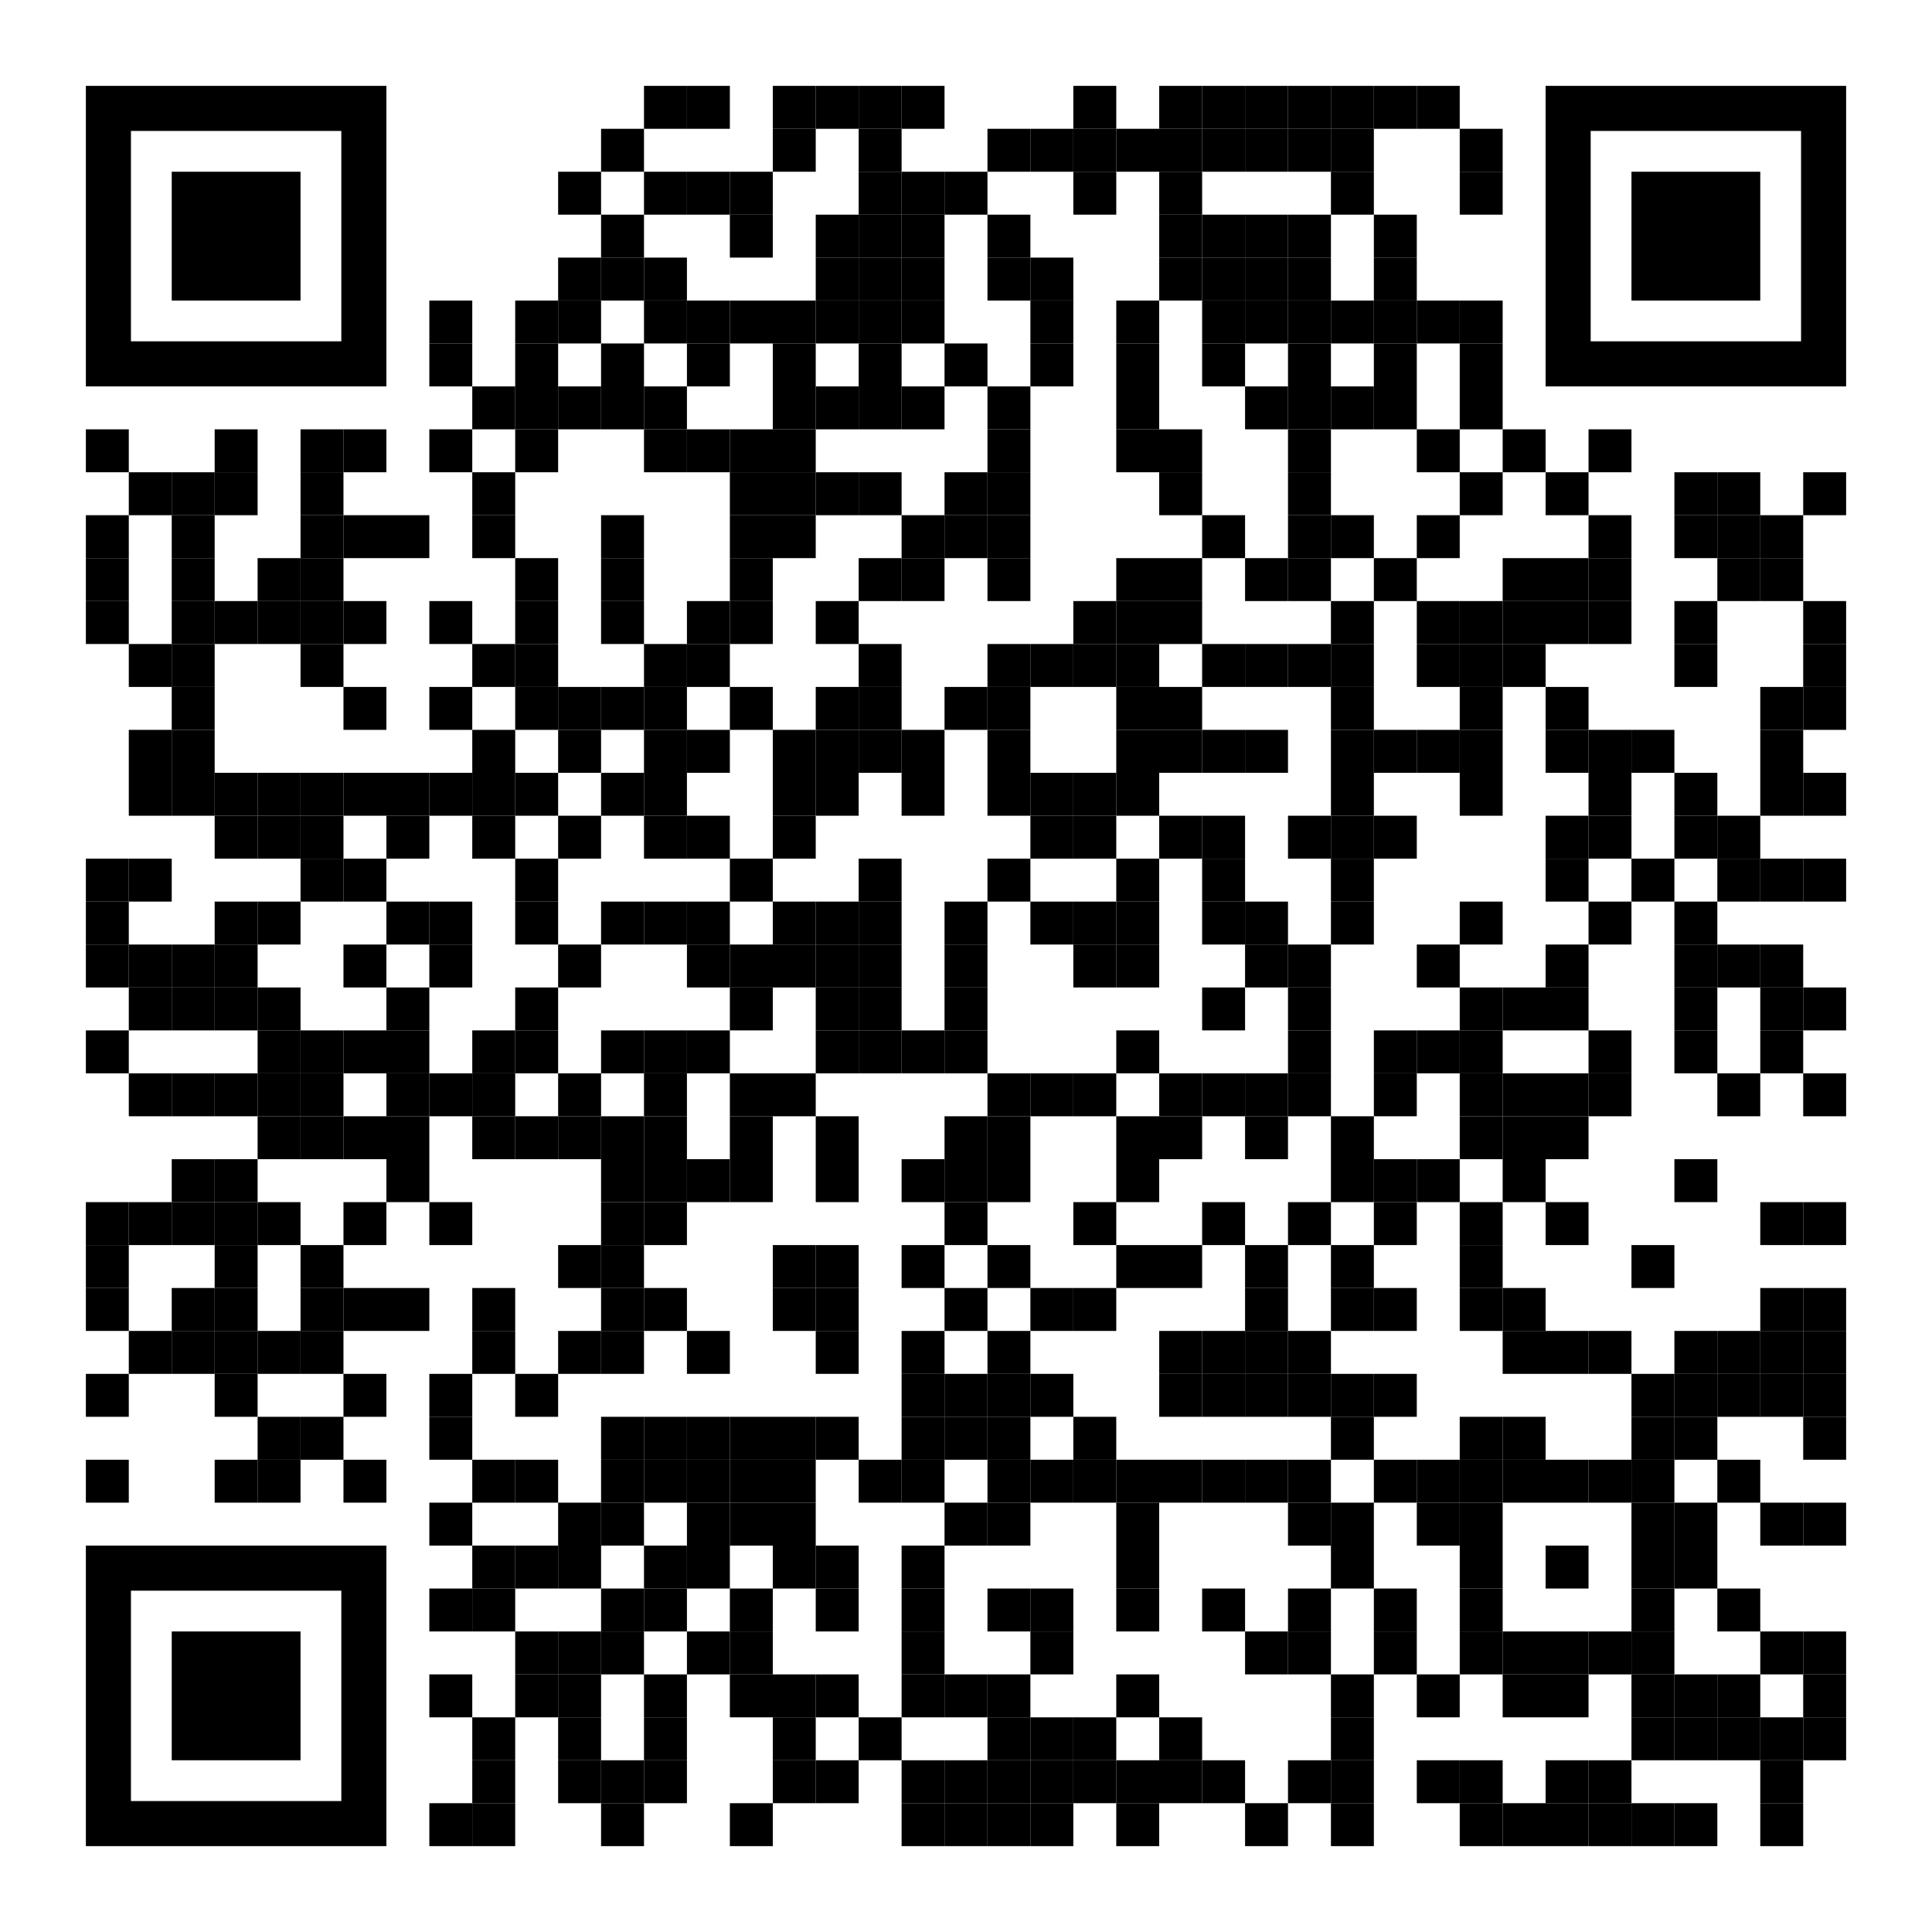
https://github.com/isidore/Talks/blob/master/BDDvsEvilProgrammer.md

Slide 4
Rules:

Slide 5
Rule #1 All tests must pass

Slide 6
Rule #2 I’m not trying to help

Slide 7
Rule #3 But I’m also lazy

Slide 8

Rules for Test Scenarios
In the Past
The past already happened. No if’s or conditionals, no branches.
Sam might go to a store sometime tomorrow.
Sam went to the video store at 11:15 yesterday
Specific Details
The devil is in the details. Make sure they are clear
Create a game board.
Create a crossword board that is 18 x 23
Avoid Symmetry
Symmetry is a smell in test as you can easily get a false positive
Place a piece at (5,5).
Place a piece at (4,5)
Happy Path
Sketch out the main things that can go right before focusing on what can go wrong
It’s illegal to place a piece on an …
Player 1 puts an X in the middle to win
Reality is Optional
You only need to use realistic situations when they are also convenient. Otherwise, don’t
Password = 2FX_V?Az8Wm/9CuZ%
Password = Password
Start Simple
You are building complexity, don’t start with it.
3*5/4² = 0.9375
1+1 = 2

Slide 9
Given When Then

Slide 10
Working
Refinement
Reporting
New Feature

Slide 11
https://github.com/isidore/Talks/blob/master/BDDvsEvilProgrammer.md

Slide 12

Thank YOU (please connect via LinkedIn and Twitter)
@LlewellynFalco
youtube.com/isidoreus
LlewellynFalco.Blogspot.com approvaltests.com

